Slide 1
Genetic Algorithm

Slide 2
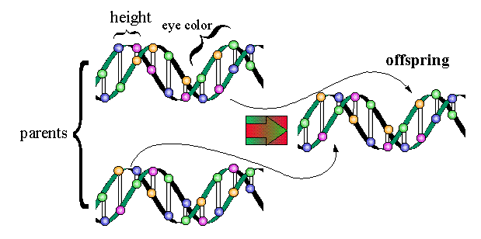
Introduction
Algorithm: An algorithm is a sequence of instructions to solve a problem. Most of the algorithms are static.
A Genetic Algorithm(GA) is adaptive (dynamic) a model of machine learning algorithm that derives its behavior from a metaphor of some of the mechanisms of evolution in nature.
Biological Background: Genetics
A gene is a short length of a chromosome which controls a characteristic of an organism.
-The gene can be passed on from parent to offspring, e.g. a gene for eye-color.(trait)
---
Living Bodies
Organism
Cell
Chromosome
Gene
DNA

Slide 3
Every Organism has set of rules describing how the organism is built. All living organisms consist of cells.
A chromosome is a chain of genes, Set of DNA. And serves as model of whole organism.
Each living object has a particular number of chromosomes, e.g. human beings have 46 chromosomes.
Possible Setting of trait is called Alleles.
Complete set of genetic material (all chromosomes) is called genome.
Particular set of genes in a genome is called genotype.
Physical expression of genotype is called Phenotype i.e. physical and mental characteristics such as eye-color, intelligence etc..
When the two organism mate ; they share their genes: the resultant offspring may end up having half the genes from one parent and half from other . This is called recombination. (Crossover)
The new created offspring can then be mutated. Mutation means that the elements of DNA are changed a bit. This changes is mainly caused by errors while copying the genes from parent.
The fitness of organism is measured by success of the organism in its life (survival)

Slide 4
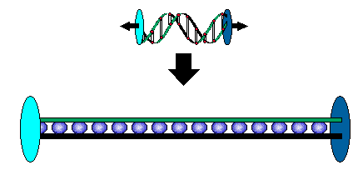
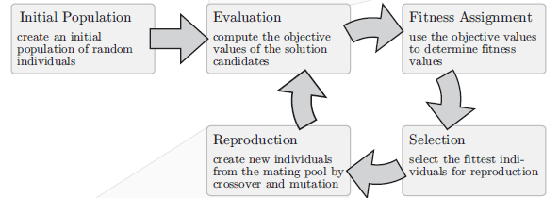
Genetic Algorithm is heuristic search algorithm based on the evolutionary ideas of natural selection and genetics.
Genetic algorithm is inspired Darwin’s Theory about evolution : Survival of fittest.
Given a problem that in some way involves a search, a genetic algorithm begins with chromosome which represents a solution (usually a binary string).
Components of GA:
- Population - consists of individuals who may be able to solve the given problem
- Fitness function – a function which determines how well each individual solves the problem
- Offspring
-child
Human Chromosome
Linear collection of bits (GA Chromosome)

Slide 5
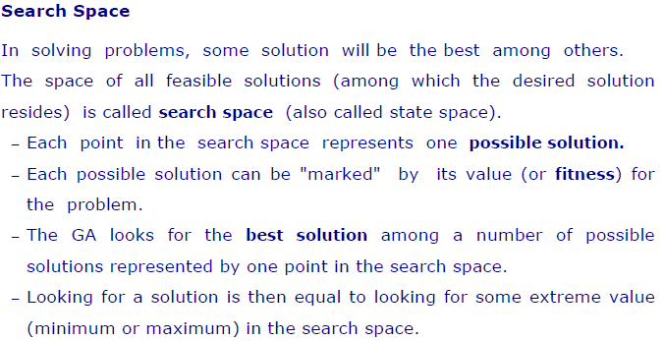

Slide 6
GA Requirements
A typical genetic algorithm requires two things to be defined:
a genetic representation of the solution domain, and
a fitness function to evaluate the solution domain.
A genetic processes to create a new better solution.
Genetic Representation
Chromosomes could be:
Bit strings (0101 ... 1100)
Real numbers (43.2 -33.1 ... 0.0 89.2)
Permutations of element (E11 E3 E7 ... E1 E15)
Lists of rules (R1 R2 R3 ... R22 R23)
Program elements (genetic programming)
... any data structure ...

Slide 7
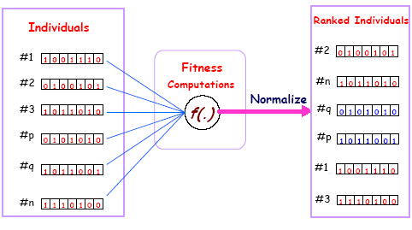
Fitness function: The fitness function is defined over the genetic representation and measures the quality of the represented solution.
The fitness function is always problem dependent.

Slide 8
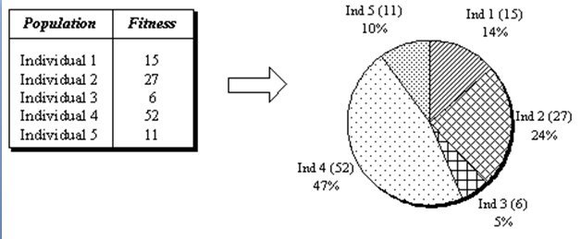
Processes Within Genetic Algorithms
As already noted, genetic algorithms try to mimic evolution. To do this, they use three basic processes.
Reproduction: Production of new generations ,For reproduction
following operations are proceeded:
Selection : Reproduction is done using parents with higher fitness ratings, that is having a higher probability of finding the answer to problems: roulette wheel technique
Crossover: Changing the code within two strings at a random place and creating two new strings of code by merging the ‘split’ strings. This process is used in nature where genes from parents combine to form a whole new chromosome.

Slide 9
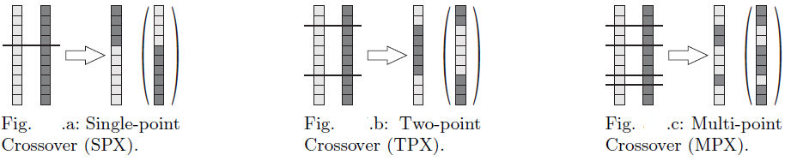
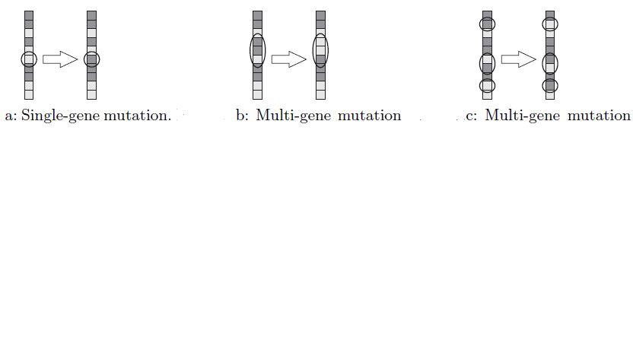
Mutation: Changing one digit or more in the code on a random basis. For example, changing a 1 to a 0 without the processes of reproduction or crossover. This mimics random changes in genetic code and is especially useful where crossover does not provide an answer. Generally, Mutation probability is given by,
rule of thumb (Pm) = 1/no. of bits in chromosome

Slide 10
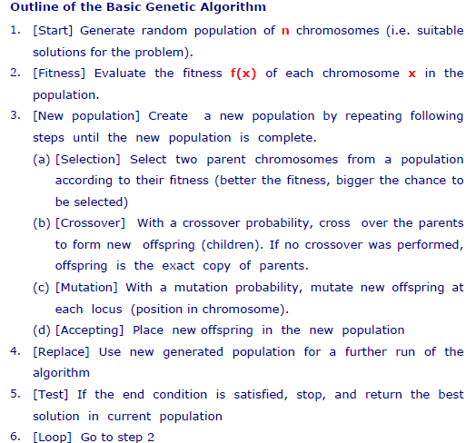

Slide 11
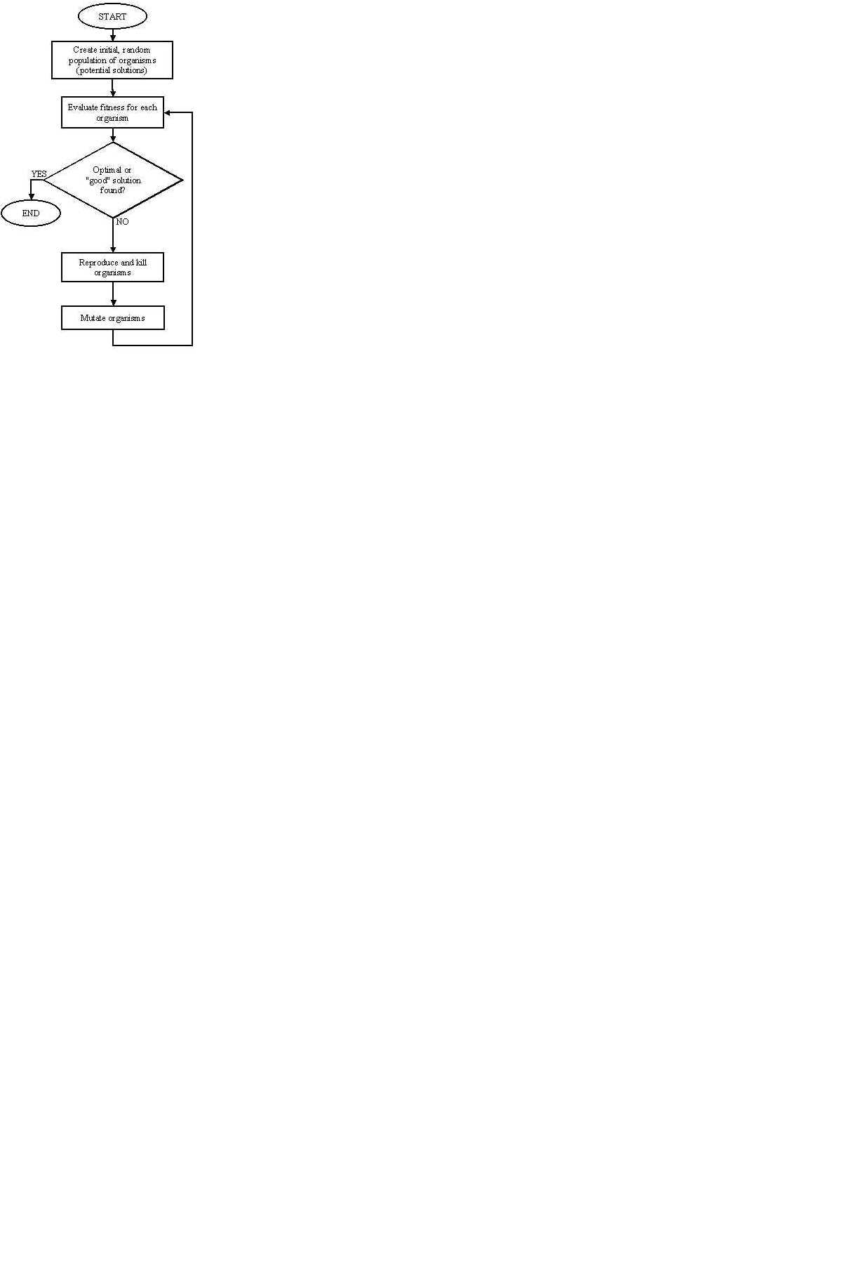
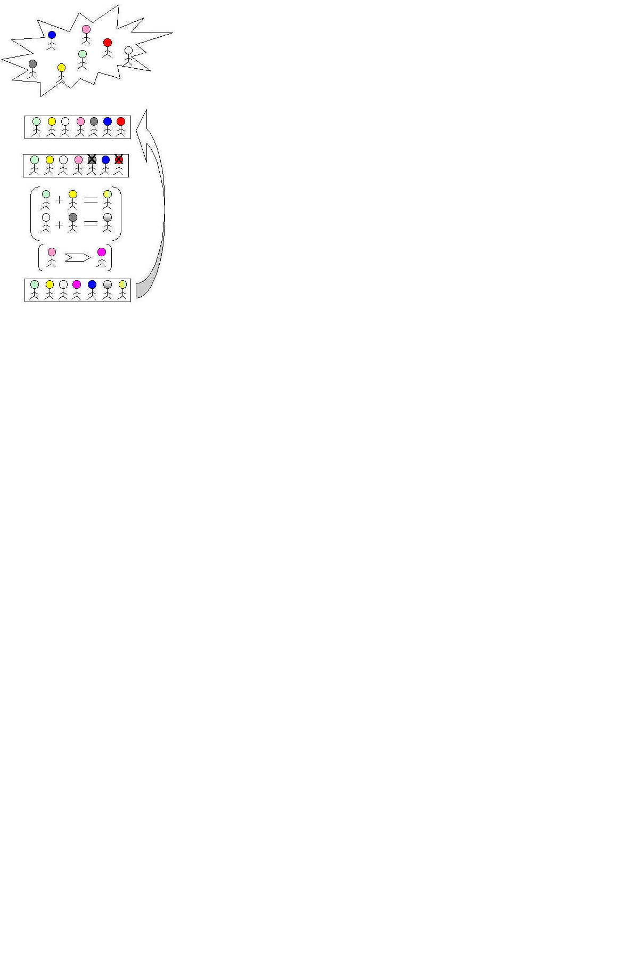

Slide 12
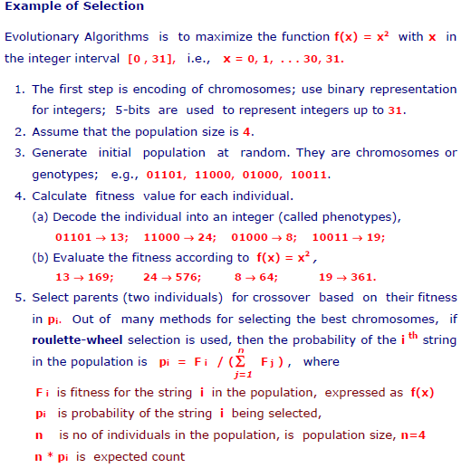

Slide 13
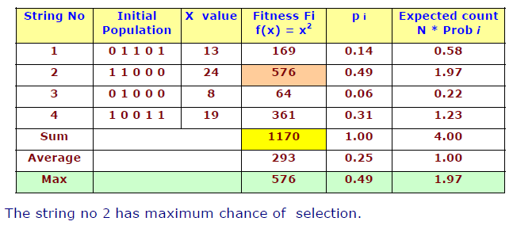
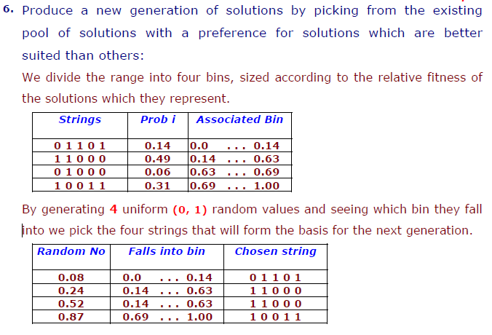

Slide 14
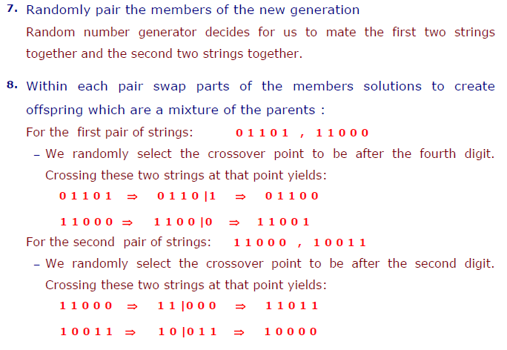

Slide 15
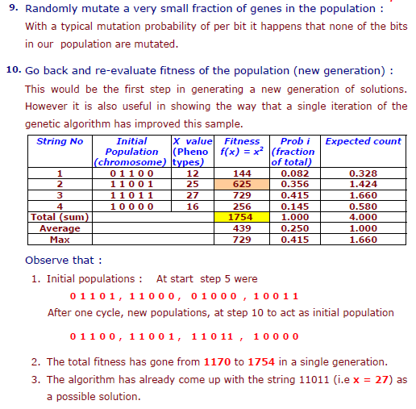

Slide 16
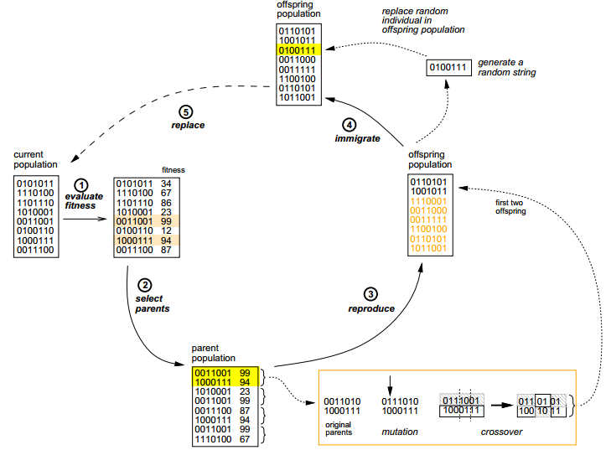

Slide 17
Another Example: Checkboard
We are given an n by n checkboard in which every field can have a different colour from a set of four colors.
Goal is to achieve a checkboard in a way that there are no neighbours with the same color (not diagonal)

Slide 18
Checkboard example Cont’d
Chromosomes represent the way the checkboard is colored.
Chromosomes are not represented by bitstrings but by bitmatrices
The bits in the bitmatrix can have one of the four values 0, 1, 2 or 3, depending on the color.
Crossing-over involves matrix manipulation instead of point wise operating.
Crossing-over can be combining the parential matrices in a horizontal, vertical, triangular or square way.
Mutation remains bitwise changing bits in either one of the other numbers.
This problem can be seen as a graph with n nodes and (n-1) edges, so the fitness f(x) is defined as:
f(x) = 2 · (n-1) ·n

Slide 19
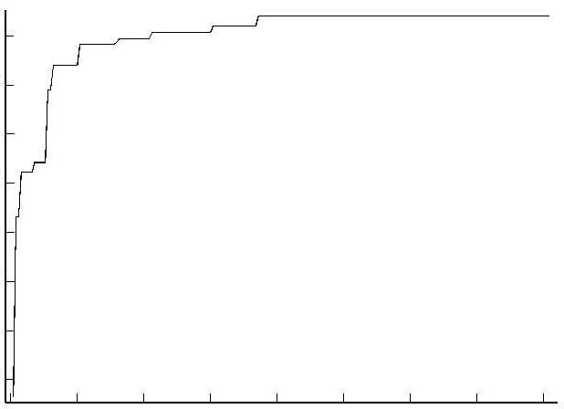
genetic algorithm learning
Fitness criteria
-70 -60 -50 -40
0 50 100 150 200
Generations
http://www.demon.co.uk/apl385/apl96/skom.htm
Notes:
Example of diagnostic (2)

Slide 20
Use of Genetic Algorithms
Genetic algorithms are used to solve many large problems including:
-Scheduling
- Transportation
-Chemistry, Chemical Engineering
- Layout and circuit design
-Medicine
-Data Mining and Data Analysis
-Economics and Finance
-Networking and Communication
- Game etc.

Slide 21
Advantages and disadvantages
Advantages:
It can solve every optimization problem which can be described with the chromosome encoding.
It solves problems with multiple solutions.
Since the genetic algorithm execution technique is not dependent on the error surface, we can solve multi-dimensional, non-differential, non-continuous, and even non-parametrical problems.
Structural genetic algorithm gives us the possibility to solve the solution structure and solution parameter problems at the same time by means of genetic algorithm.
Genetic algorithm is a method which is very easy to understand and it practically does not demand the knowledge of mathematics.
Genetic algorithms are easily transferred to existing simulations and model
Disadvantages
May be Slow
May be drop of the quality because of crossover.

Slide 22
References
http://www.ro.feri.uni-mb.si/predmeti/int_reg/Predavanja/Eng/3.Genetic%20algorithm/_18.html
Introduction to Knowledge engineering : eBook, chapter 2; page 66.
Global Optimization Algorithms– Theory and Application – eBook Thomas Weise, 2009
Lecture Slide1: Genetic Algorithm for Variable Selection Jennifer Pittman ISDS Duke University
Lecture Slide2: Fundamental of Genetic Algorithms : AI course Lecture, BY RC chakraborty
Lecture Slide 3: Genetic Algorithms by Muhannad Harrim
Lecture Slide 4: Artificial Intelligence: Genetic Algorithms Dr. Richard Spillman PLU
Fall 2003
Recommended:
Holland, J. (1992), Adaptation in natural and artificial systems , 2nd Ed. Cambridge: MIT Press
Goldberg, D. (1989), Genetic algorithms in search, optimization and machine learning. Addison-Wesley.

Slide 23
Thank you! Any queries ? Please!!

